Slide 1
Local Area Networks
Project 802
Ethernet
Token Ring
Token Bus
FDDI (ANSI standard)

Slide 2
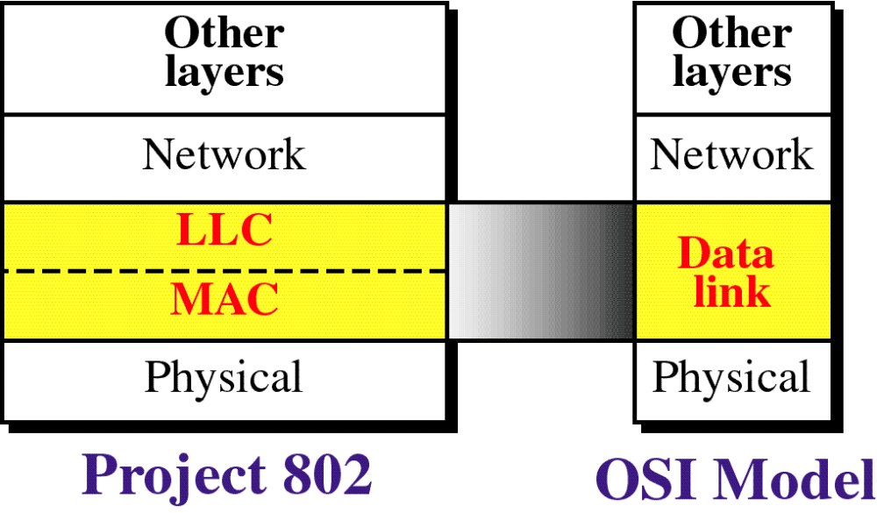
OSI Model and Project 802

Slide 3
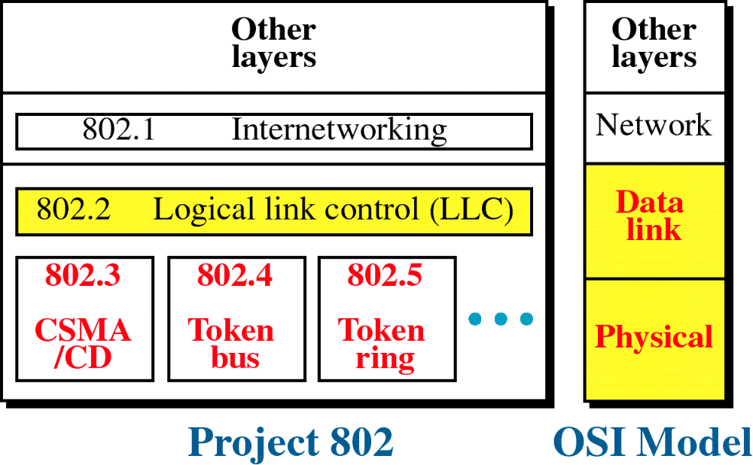
Project 802

Slide 4
IEEE project 802 model
Takes structure of HDLC frame and divides it into 2 sets of functions:
End-user portions of the frame:
Logical addresses, control information, and data (handled by LLC)
Contention for the shared media:
Synchronization, flag, flow, and error control (handled by MAC)

Slide 5
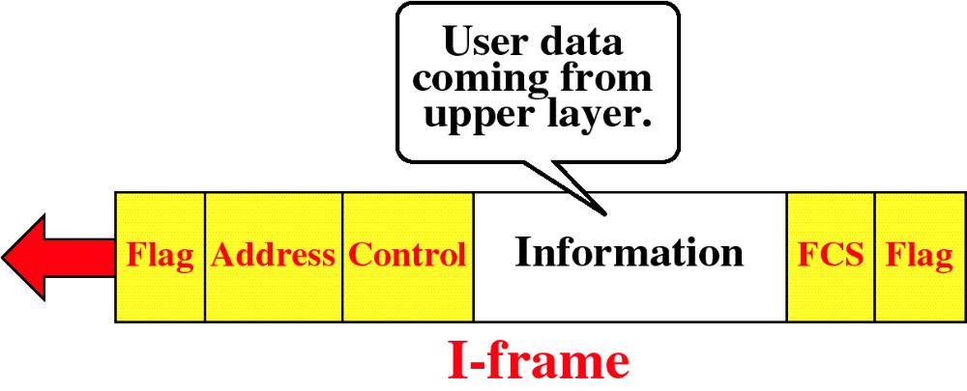
HDLC Frame Types

Slide 6
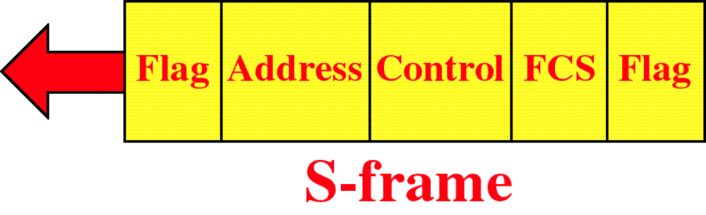
HDLC Frame Types

Slide 7
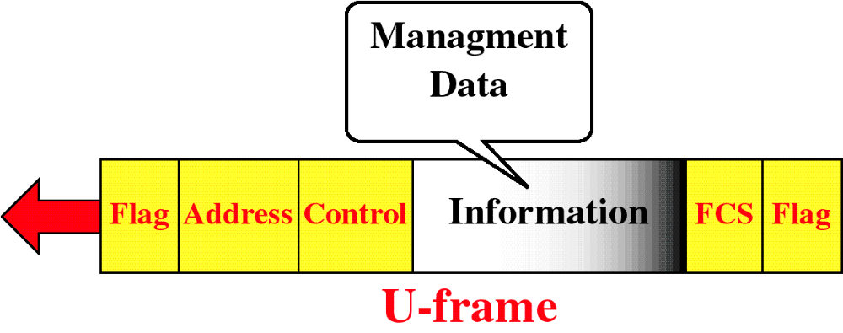
HDLC Frame Types

Slide 8
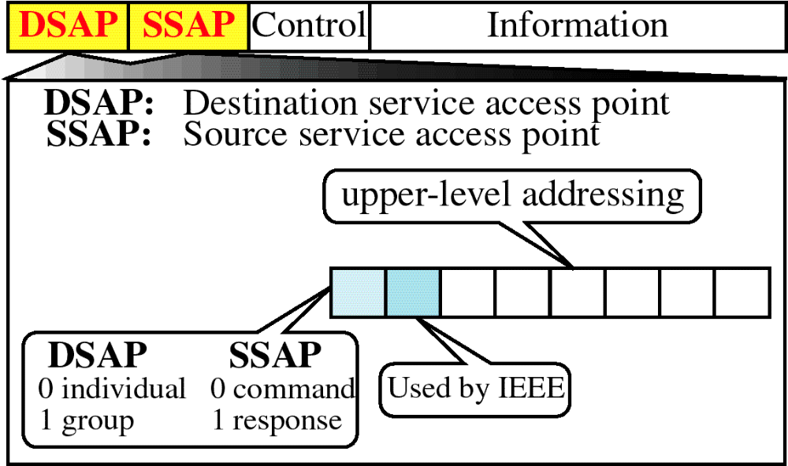
PDU Format

Slide 9
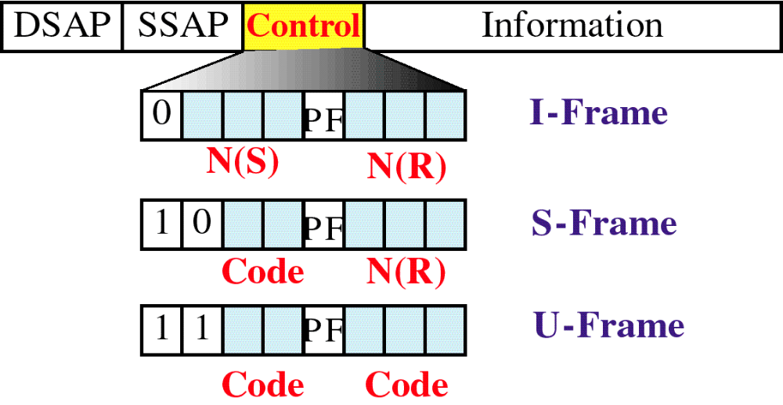
PDU Control Field

Slide 10
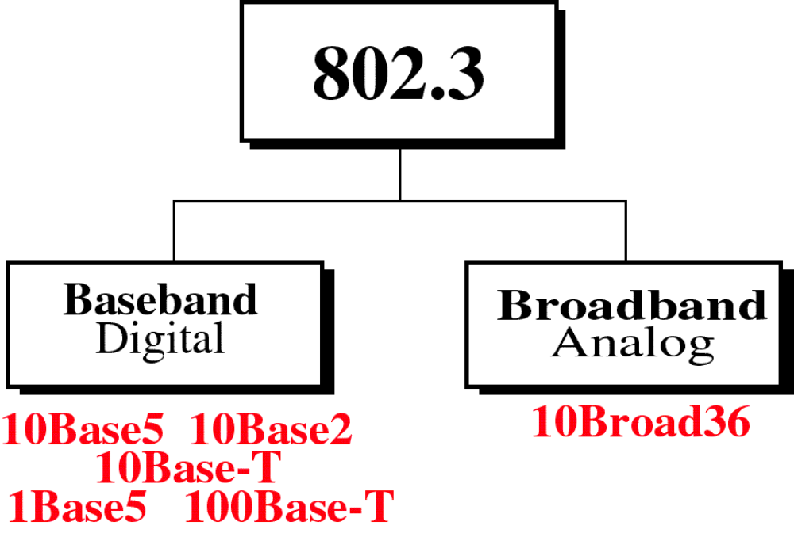

Slide 11
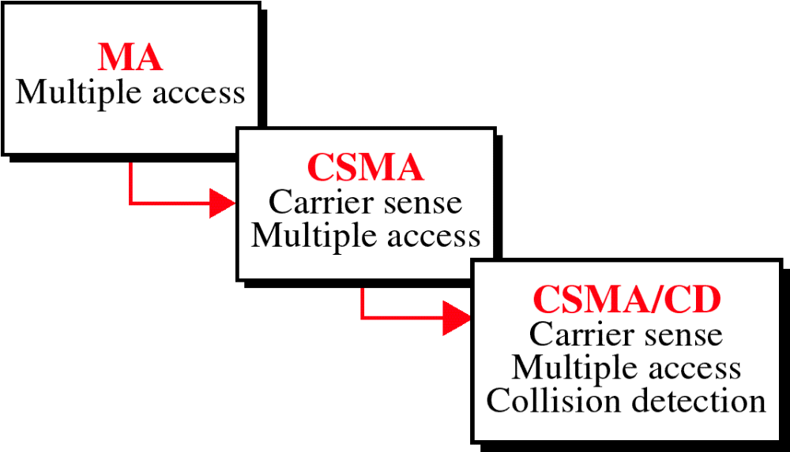
Evolution of CSMA/CD

Slide 12
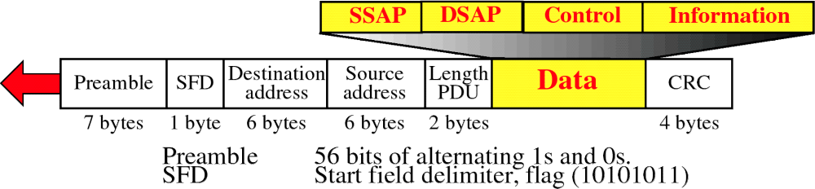
MAC Frame

Slide 13
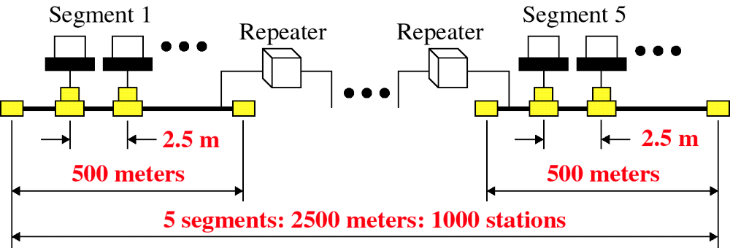
Ethernet Segments

Slide 14
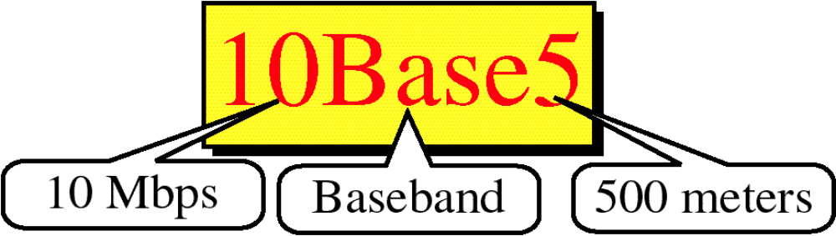

Slide 15
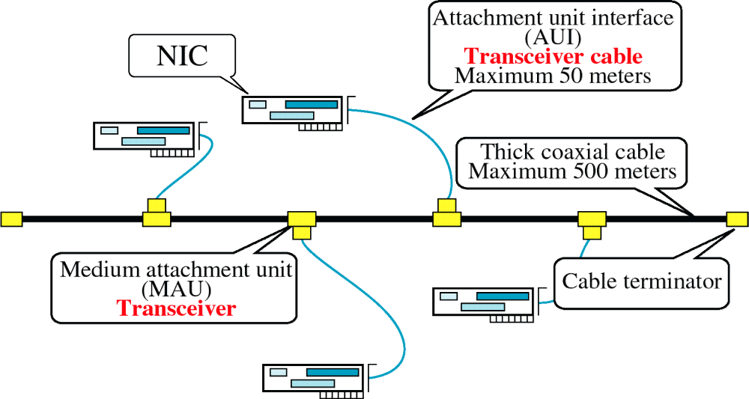
10BASE5

Slide 16
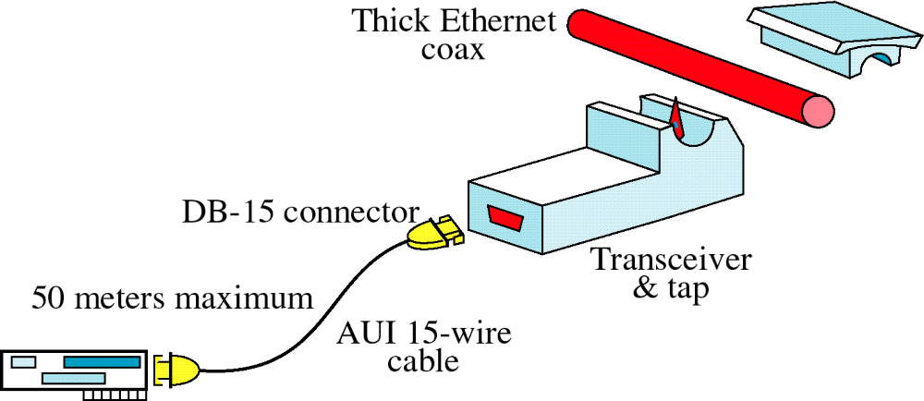
Transceiver

Slide 17
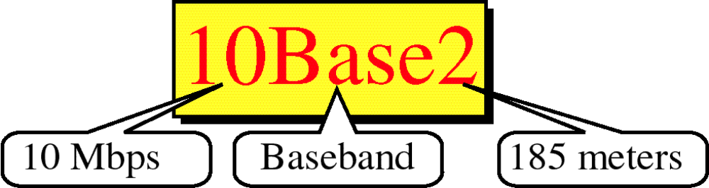

Slide 18
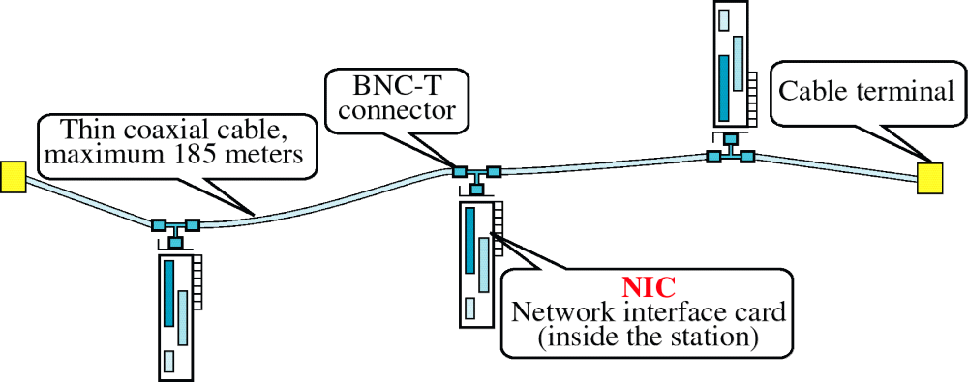
10BASE2

Slide 19
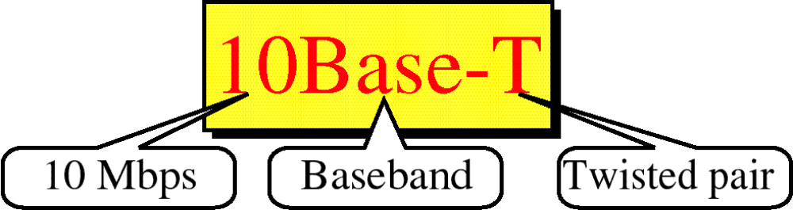

Slide 20
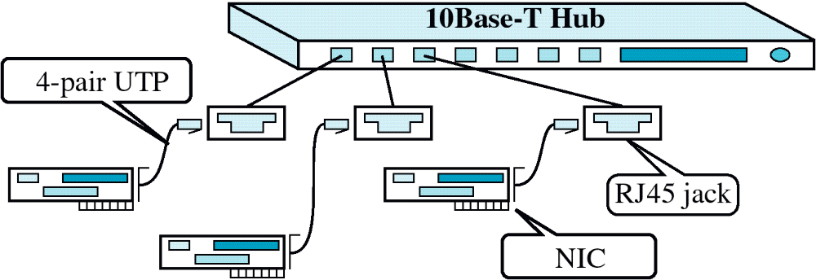
10BASET

Slide 21
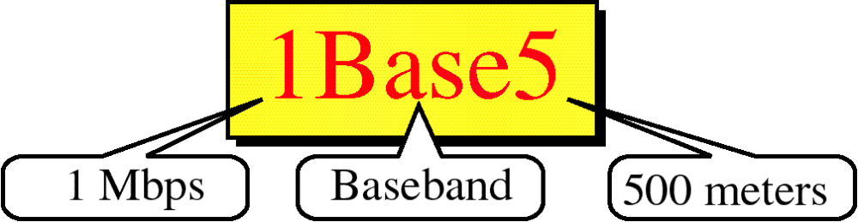

Slide 22
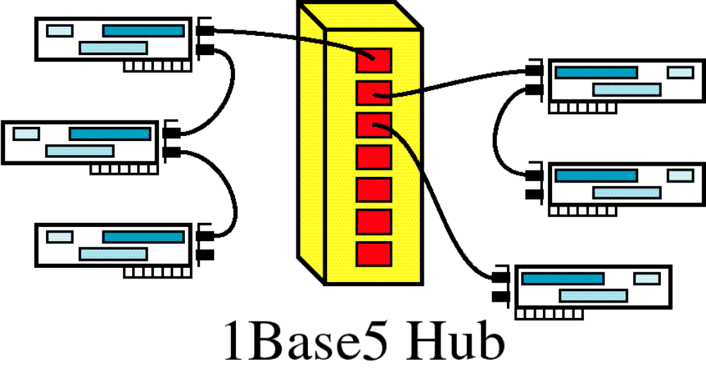
1BASE5

Slide 23
